Slide 1
SI 506: Programming I
Fall 2022
Lecture 21
Anthony Whyte <arwhyte@umich.edu>
Lecturer III, School of Information
715 N. University Ave, Ann Arbor, MI 48109
Roumanis Square, 2nd floor (“the loft”)

Slide 2
Internet
HTTP/1.1 request/response cycle
request
https://swapi.py4e.com/
DNS
104.28.13.91
CLIENT
SERVER
response
Note: direct access to IP address blocked by Cloudflare.

Slide 3
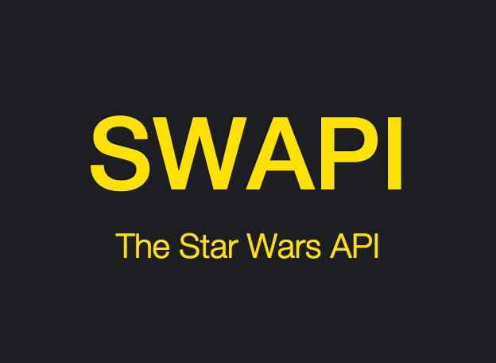
API
application programming interface
https://swapi.py4e.com/api/
CLIENT
request
SERVER
API
response
HTTP/1.0 200 OK
(status code)

Slide 4
HTTP Protocol
HTTP methods
GET
PUT
POST
DELETE

Slide 5
Star Wars
movie franchise

Slide 6
Chewbacca
Wookiee: known affectionately as Chewie

Slide 7
T-65 X-wing starfighter
Rebel ship

Slide 8
finis

Slide 9
Slide deck revisions
errata: corrections and other changes
Slide no(s). | Fix ver. | Description
 | v1p1

